Slide 1

Handwritten Math Solver

Slide 2

Topics to be covered
Intro
Architecture
Brief on CNN
Model Layers and Parameters
Model Evaluation
Conclusion
Future Scope
Demo

Slide 3



Inspiration
Microsoft Math Solver
Air Math
Brainly

Slide 4
Problem Statement
Goal is to develop a machine learning model that can solve mathematical problems expressed in handwritten format from the given input.

Slide 5
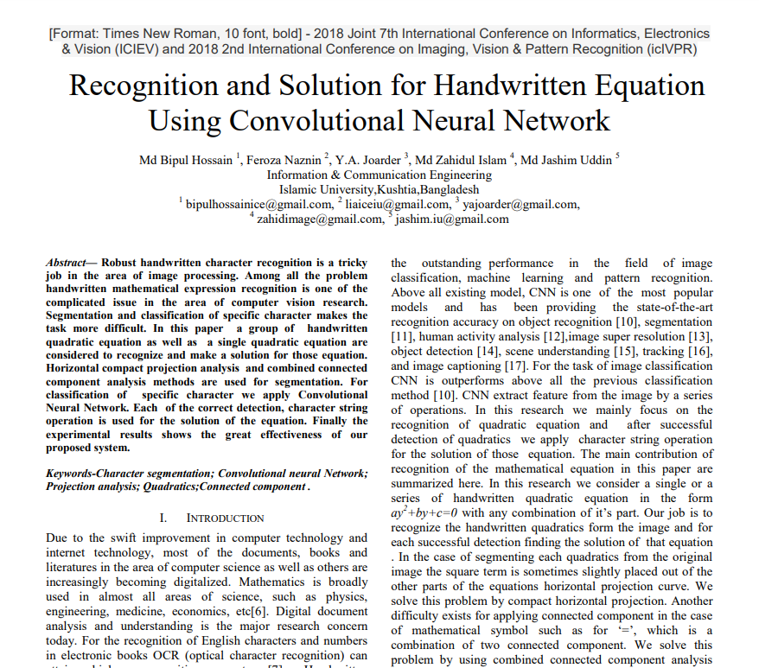
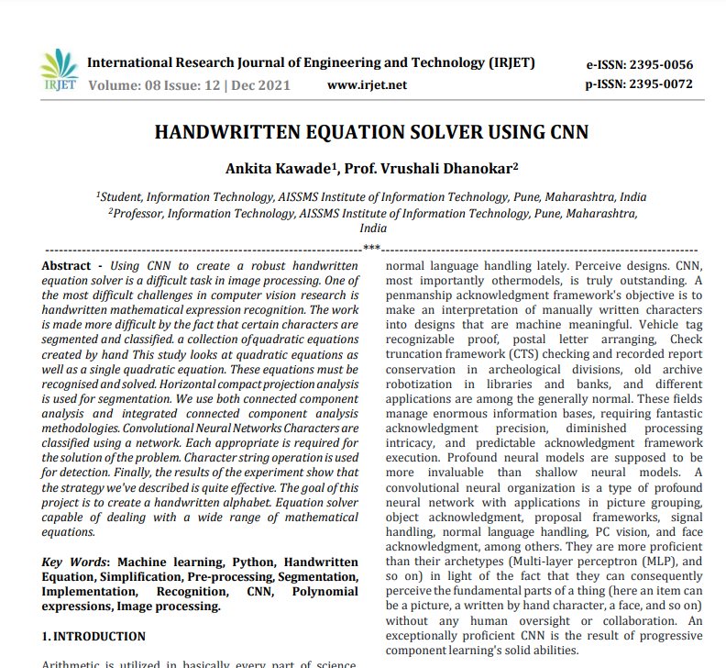
Related Research

Slide 6
Proposed Solution
Using a CNN model to recognise digits and symbols from a hand written mathematical problem and providing a precise solution on it.

Slide 7
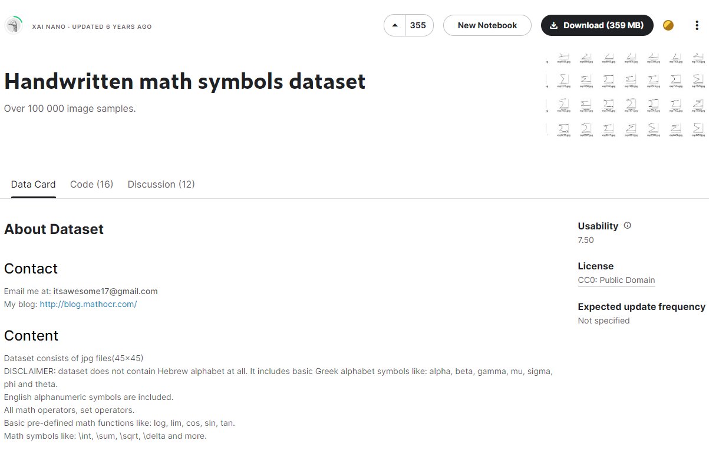
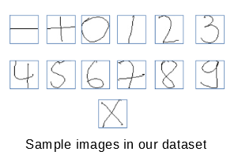
Dataset
Data extracted from Kaggle
It contains Numbers ranging from 0 – 9 and mathematical symbols.

Slide 8
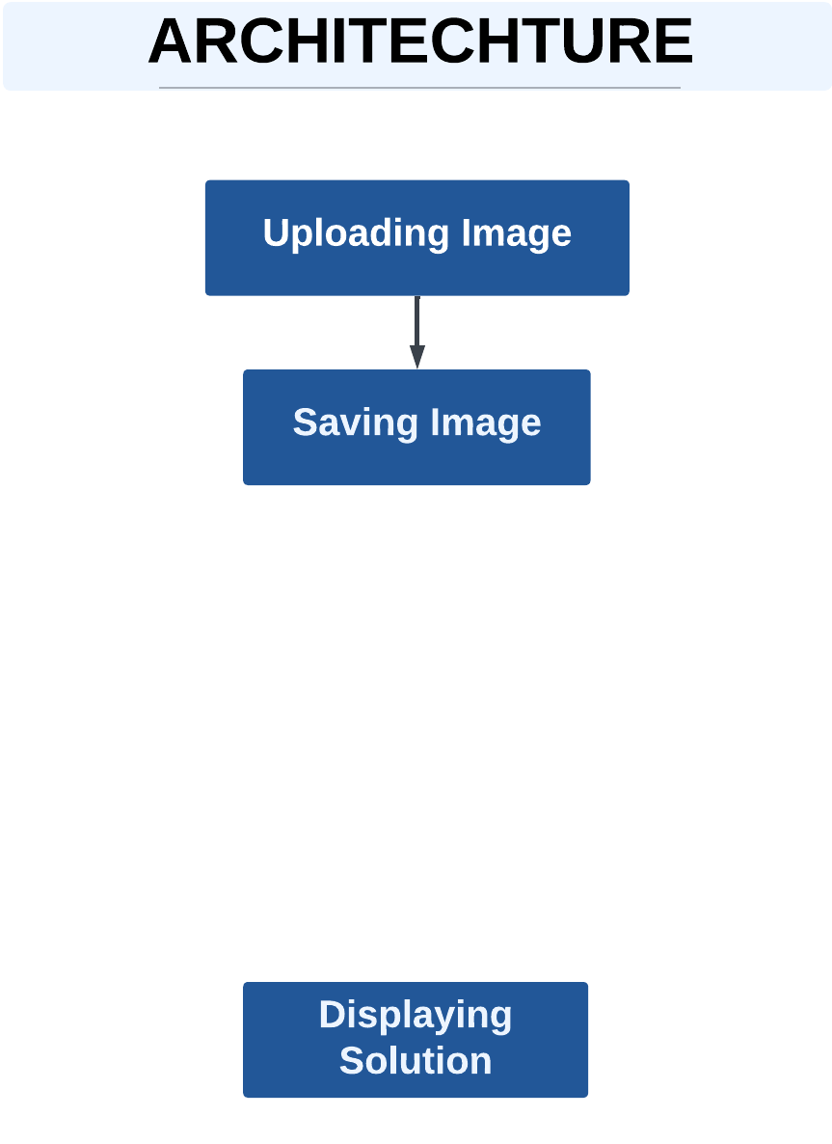
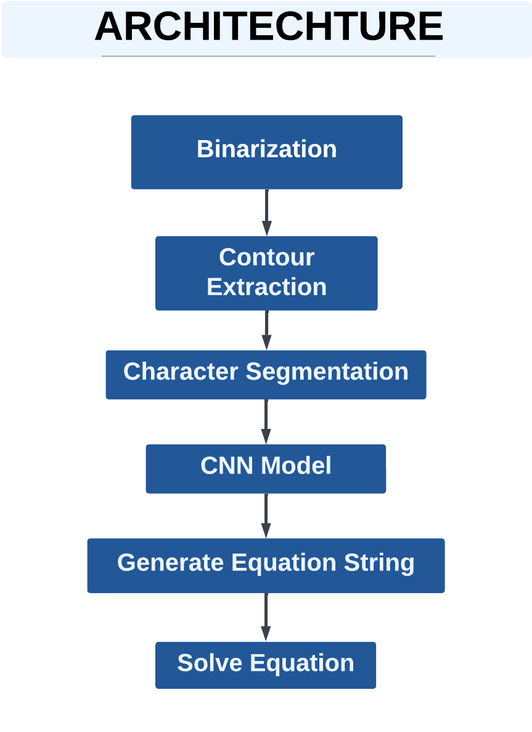
High Level Architecture
Front End
Back End

Slide 9
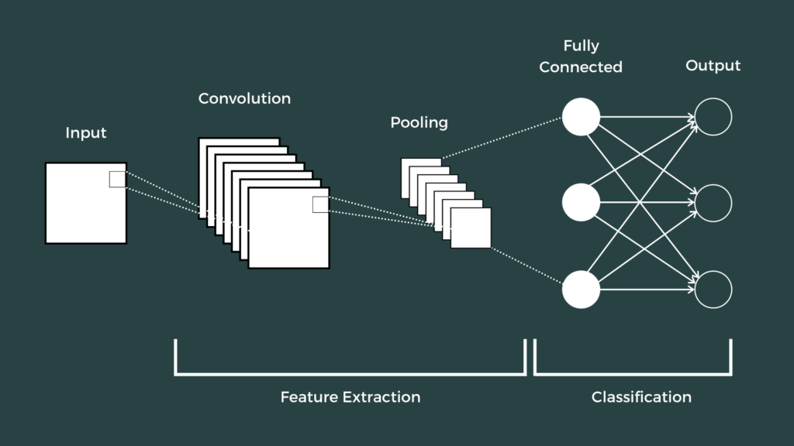
CNN – Convolutional Neural Network
Convolutional Neural Network (CNN) is among the class of deep neural networks.
Its inspiration comes from Human Visual Cortex.
It is better at holding the spatial arrangement of pixel.

Slide 10

CNN Flowchart

Slide 11
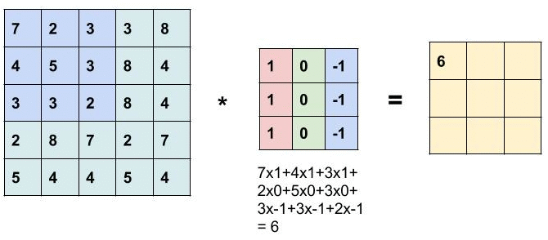
Convolutional Operation
Edge Detection
White – 255
Black – 0
Filter / Kernel (3 x 3)
255 | 255 | 255 | 255 | 255 | 255
255 | 255 | 255 | 255 | 255 | 255
255 | 255 | 255 | 255 | 255 | 255
0 | 0 | 0 | 0 | 0 | 0
0 | 0 | 0 | 0 | 0 | 0
0 | 0 | 0 | 0 | 0 | 0
-1 | -1 | -1
0 | 0 | 0
1 | 1 | 1
*
How is the Calculation is been done.
Horizontal Edge Detection
6 x 6

Slide 12
Feature Map
255 | 255 | 255 | 255 | 255 | 255
255 | 255 | 255 | 255 | 255 | 255
255 | 255 | 255 | 255 | 255 | 255
0 | 0 | 0 | 0 | 0 | 0
0 | 0 | 0 | 0 | 0 | 0
0 | 0 | 0 | 0 | 0 | 0
0 | 0 | 0 | 0
255 | 255 | 255 | 255
255 | 255 | 255 | 255
0 | 0 | 0 | 0
-1 | -1 | -1
0 | 0 | 0
1 | 1 | 1
*
=
6 x 6 Matrix

Slide 13
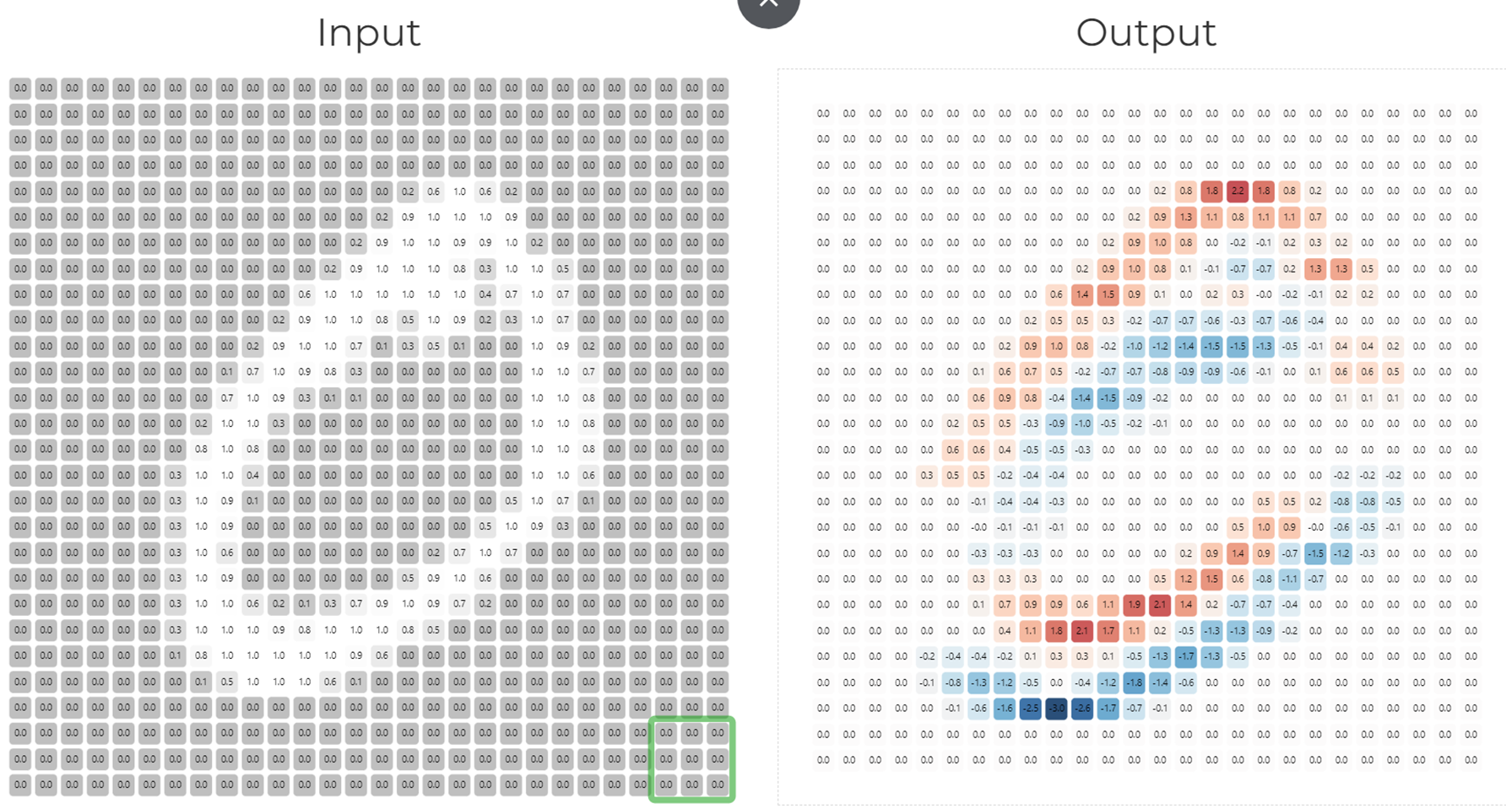

Convolution Operation Results

Slide 14
Padding
A |  |  |  |  | A
 |  | C | C
 |  | C | C
A |  |  |  |  | A
A |  |  |  |  | A
 |  | C | C
 |  | C | C
A |  |  |  |  | A
A |  |  |  |  | A
 |  | C | C
 |  | C | C
A |  |  |  |  | A
A |  |  |  |  | A
 |  | C | C
 |  | C | C
A |  |  |  |  | A
6 x 6 Matrix with a 3 x 3 kernel
0 | 0 | 0 | 0 | 0 | 0 | 0 | 0
0 | A |  |  |  |  | A | 0
0 |  |  |  |  |  |  | 0
0 |  |  | C | C |  |  | 0
0 |  |  | C | C |  |  | 0
0 |  |  |  |  |  |  | 0
0 | A |  |  |  |  | A | 0
0 | 0 | 0 | 0 | 0 | 0 | 0 | 0

Slide 15
0 | 0 | 0 | 0 | 0 | 0 | 0 | 0
0 | A |  |  |  |  | A | 0
0 |  |  |  |  |  |  | 0
0 |  |  | C | C |  |  | 0
0 |  |  | C | C |  |  | 0
0 |  |  |  |  |  |  | 0
0 | A |  |  |  |  | A | 0
0 | 0 | 0 | 0 | 0 | 0 | 0 | 0
0 | 0 | 0 | 0 | 0 | 0 | 0 | 0
0 | A |  |  |  |  | A | 0
0 |  |  |  |  |  |  | 0
0 |  |  | C | C |  |  | 0
0 |  |  | C | C |  |  | 0
0 |  |  |  |  |  |  | 0
0 | A |  |  |  |  | A | 0
0 | 0 | 0 | 0 | 0 | 0 | 0 | 0
0 | 0 | 0 | 0 | 0 | 0 | 0 | 0
0 | A |  |  |  |  | A | 0
0 |  |  |  |  |  |  | 0
0 |  |  | C | C |  |  | 0
0 |  |  | C | C |  |  | 0
0 |  |  |  |  |  |  | 0
0 | A |  |  |  |  | A | 0
0 | 0 | 0 | 0 | 0 | 0 | 0 | 0
0 | 0 | 0 | 0 | 0 | 0 | 0 | 0
0 | A |  |  |  |  | A | 0
0 |  |  |  |  |  |  | 0
0 |  |  | C | C |  |  | 0
0 |  |  | C | C |  |  | 0
0 |  |  |  |  |  |  | 0
0 | A |  |  |  |  | A | 0
0 | 0 | 0 | 0 | 0 | 0 | 0 | 0
0 | 0 | 0 | 0 | 0 | 0 | 0 | 0
0 | A |  |  |  |  | A | 0
0 |  |  |  |  |  |  | 0
0 |  |  | C | C |  |  | 0
0 |  |  | C | C |  |  | 0
0 |  |  |  |  |  |  | 0
0 | A |  |  |  |  | A | 0
0 | 0 | 0 | 0 | 0 | 0 | 0 | 0
0 | 0 | 0 | 0 | 0 | 0 | 0 | 0
0 | A |  |  |  |  | A | 0
0 |  |  |  |  |  |  | 0
0 |  |  | C | C |  |  | 0
0 |  |  | C | C |  |  | 0
0 |  |  |  |  |  |  | 0
0 | A |  |  |  |  | A | 0
0 | 0 | 0 | 0 | 0 | 0 | 0 | 0

Slide 16
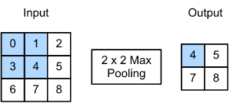

Max-Pooling

Slide 17

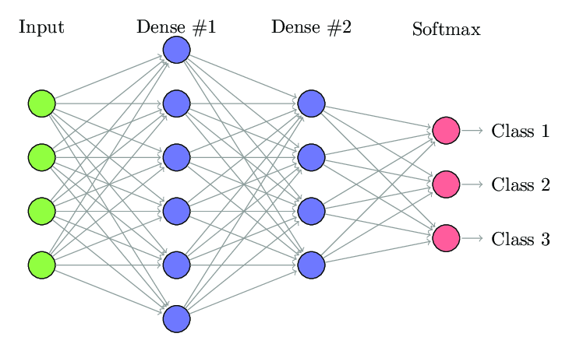
Dense – Fully Connected Layer
It does the Classification.
It is Prone to Overfitting.

Slide 18
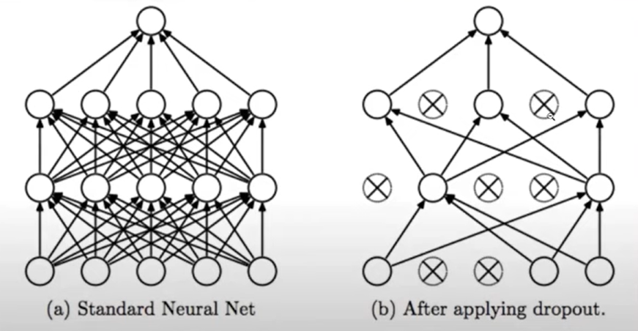
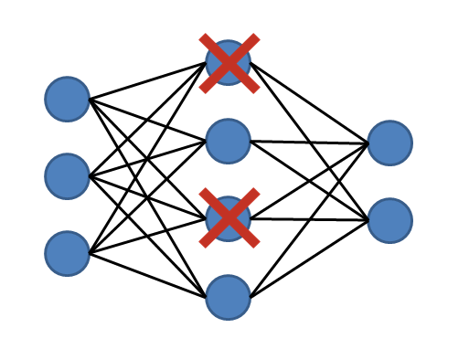
Dropout
To reduce the overfitting.
Usually increases accuracy by 2%.

Slide 19

Convolutional Neural Network

Slide 20
Flow of the Back-end Code :
Binarization
Inverting Image
Contour Detection
Character Segmentation
Digit Classification using the CNN model
Converting into a string
Solving the equation using EVAL()

Slide 21
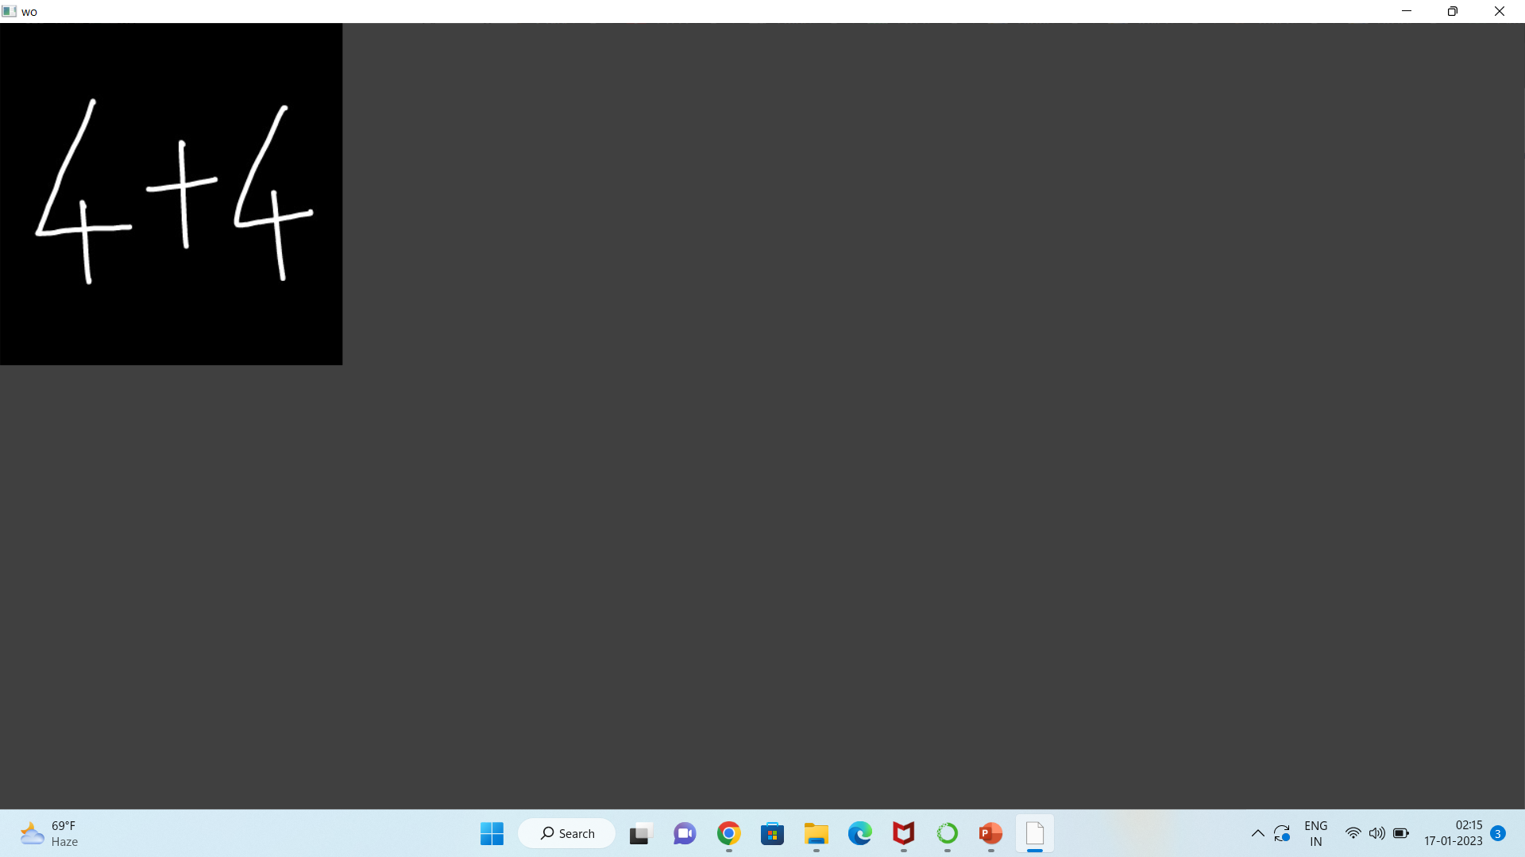
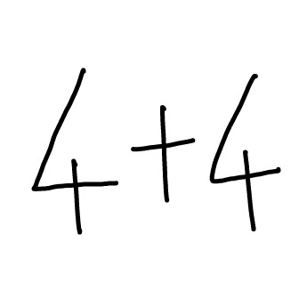
Binarization and Inverting Image

Slide 22
Contour Detection and Character Segmentation

Slide 23
Each Character Extracted is Reshape into 28x28x1size and then given as input into the CNN model

Slide 24
Further Process
After character segmentation, each image is passed into the CNN model for digit detection.
After detecting the digit the equation is converted into a string
The String equation is solved using EVAL()

Slide 25
Model Layers
Operational Layer | Input | Output
Convolutional 2D | 28,28,1 | 28,28,32
Max Pooling 2D | 28,28,32 | 14,14,32
Convolutional 2D | 14,14,15 | 12,12,15
Max Pooling 2D | 12,12,15 | 6,6,15
Flatten | 6,6,15 | 540
Drop Out | 540 | 540
Dense | 540 | 128
Dense | 128 | 50
Dense | 50 | 13

Slide 26
Training Parameters
DATASET | Kaggle
EPOCHS | 10
LEARNING RATE | 0.01
OPTIMIZER | ADAM
LOSS FUNCTION | Categorical Cross Entropy
ACCURACY METRIC | Accuracy
ACCURACY ACHIEVED | 0.98

Slide 27
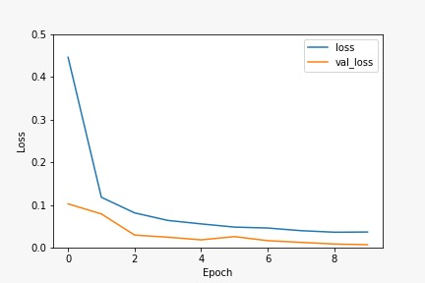
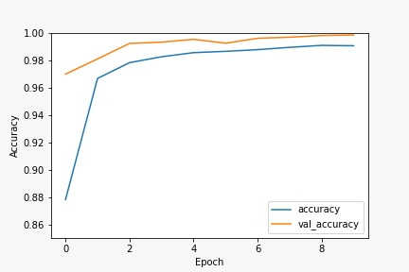
Model Evaluation
Loss vs Epochs
Accuracy vs Epochs

Slide 28
Conclusion
In conclusion, this model can be useful in various fields such as banking, education, and research.
It can be used to digitize handwritten documents, automate data entry, and can be integrated into smart devices such as calculators, smart-watches, and mobile phones.

Slide 29
Future Scope
Solving Linear Models.
Providing Visualisation on the provided equations.
Giving an Explanation of the solution.

Slide 30
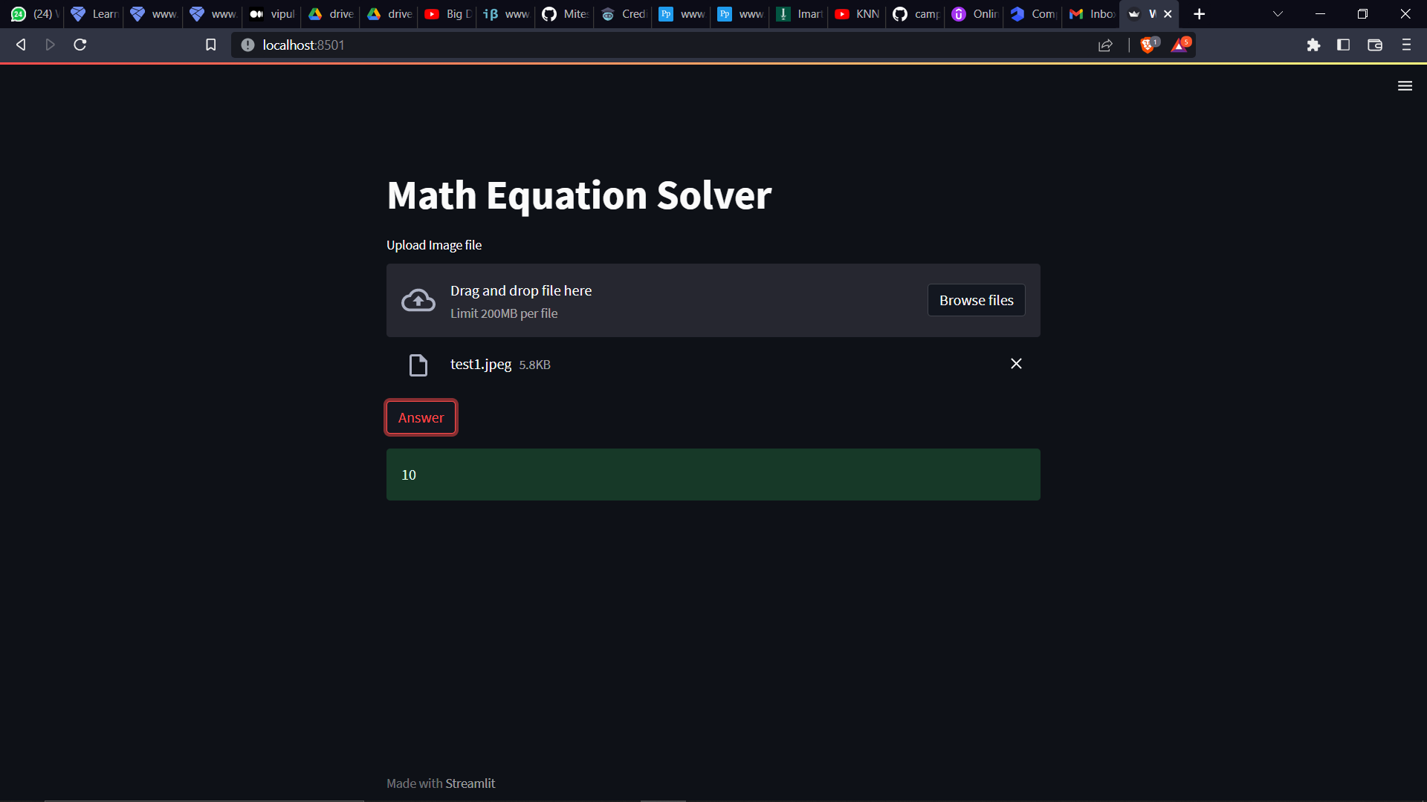
Demo

Slide 31


Slide 32
Loss Function – Categorical Cross Entropy

Slide 33
Optimiser – Adam

